Slide 1
Apples Galore
By: Alicia Lan, Nathan Ong, Priya Sekhon, and Sean Dao
Churchill Secondary School

Slide 2
Introduction: the Apple
What is an apple?
An apple is the pomaceous fruit of the apple tree.
Species: Malus domestica in the rose family (Rosaceae).
One of the most widely cultivated tree fruits.
Apples can be used in a variety of different ways such as pies, cakes and tarts.

Slide 3
The History of the Apple
The original home of the apples is Kazakhstan.
Explorer Samuel Champlain brought them to Canada in the early 17th century.
European settlers planted apple orchards soon after they arrived.
Grafted fruit trees came to B.C. by wagon.
Apple trees are not grown from seeds but had to be grafted onto another tree.
Hudson’s Bay Company planted first apple tree in B.C. on Vancouver Island.

Slide 4
Importance of the Apple to British Columbia.
We as Canadians have a long history of growing apples
About 98% of B.C. apples are produced in the Okanagan-Similkameen valleys.
BC produces about 30% of the apples grown in Canada.
We have perfect weather here for growing apples.
People love to eat apples.
We have been growing them for a hundred or more years.
Apples are also grown on Vancouver Island, the Fraser Valley and Kootenay areas.
B.C. apples are about 80% of all B.C. tree fruit production.

Slide 5
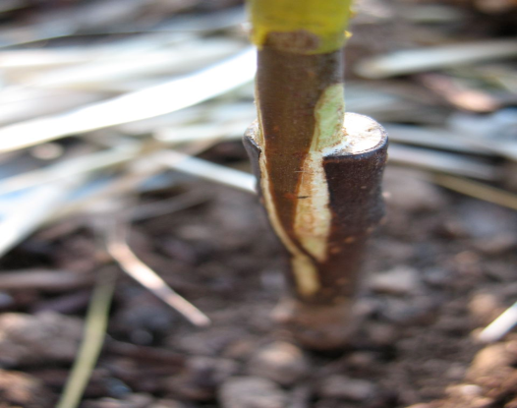
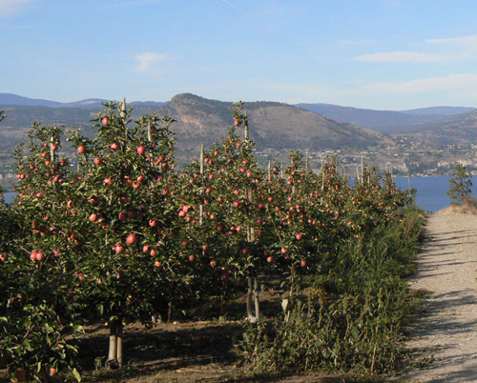
Family, Community, & Provincial Links to BC
1800’s
Apples were transported to market by cart and ice barges.
Arrival of fresh produce in Vancouver: great excitement!
Most valuable edible crop in B.C.
B.C. produces 27% of apples in Canada.
Fruit basket of Canada.
Important part of Okanagan economy and history.
7% of BC workforce employed in apple industry.
Some apples, such as Granny Smith, have European heritage.
Apple orchards created city of Kelowna.
Spartan apple developed and grown in B.C.
Picture: Grafting
Okanagan

Slide 6
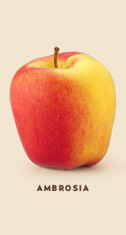
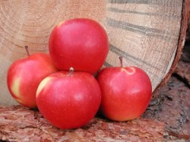
Apples in B.C.
Ambrosia
Original B.C. creation
Started with a chance seedling in a family orchard that was growing red and golden delicious apples
Salish
Born in B.C.
Raised in the Okanagan
A cross between Splendor and Gala apples

Slide 7
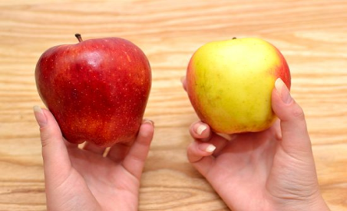
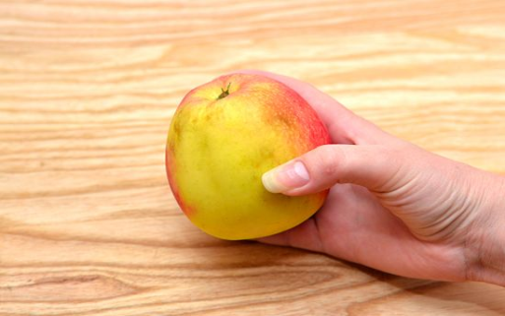
Tips on Choosing an Apple
Determine the use of the apple you are choosing.
Looking for an apple to eat with your sandwich? Then you want a ripe or nearly ripe apple with full color and no discoloration.
Looking for a "baking" apple to be used in a pie or crumble? Then look for older apples that might be just past the ripe stage and slightly mushy.
2. Pick up the apple, and feel for any soft areas and look for any discoloration.
Apples past ripeness become brown (oxidization) and feel soft or mushy.

Slide 8
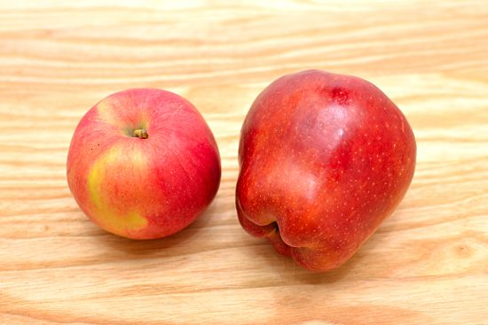
Tips on Choosing an Apple
3. Look at the shape of the apple.
A more round apple, typical of the green variety, can be a little more flavorful than the elongated types.
Round ones also tend to be younger, so when picked off the tree and eaten raw they can yield a more flavorful eating experience, but when cooked they can become bitter and too firm.

Slide 9
How to Prepare an Apple
1. Choose a type of apple suited to your purpose.
Certain apple types do exceptionally well in various types of cooking.
2. Prepare the apples for cooking.
Wash the apples and drain them well.
Peel apples if needed for the recipe.
Slice or core apples as needed for recipe.
Use apples immediately after slicing to prevent browning. If using later, you can sprinkle the apple slices with lemon juice to prevent browning.
Add apple slices to 1 part lemon juice mixed with 3 parts water to prevent browning.
Use sliced apples within two hours of adding to lemon water or refrigerate apple slices stored in water for later use.

Slide 10
How to Prepare an Apple: Recipe for Baked Apples
Ingredients:
6 large apples
1/2 cup sugar or honey
1/2 teaspoon cinnamon
1/2 teaspoon nutmeg
1/2 cup raisins, optional
1 tablespoon butter or margarine
1 cup water
Instructions:
1. Preheat oven to 375° F (190° C, 170° C in a fan oven). 2. Wash and core the apples. 3. Pare the top third of apples to prevent the apples from bursting while baking. 4. Combine the sugar or honey, cinnamon and nutmeg. Add the raisins, if you are using them. 5. Stuff the apples with the sugar or honey mixture. 6. Place the apples into a greased baking pan. 7. Pour water around the apples. 8. Baste with apple juices during baking to prevent the apples from drying out. 9. Bake apples for 40-50 minutes or until they feel tender.

Slide 11
How to Store an Apple
Store apples in a cool location, preferably in the refrigerator, away from strong flavored foods.
Refrigerated apples should be eaten within 4 to 6 weeks.
2. Freezer storage:
Select firm and crisp apples for freezing.

Slide 12
Summary of Apples
Apples have been around for a long time and have been a very important and iconic fruit throughout history. From the middle east to the Okanagan valley, the apple has branched off into many varieties, such as the Spartan or Granny Smith apple. It has helped many communities grow into prosperous towns and cities, such as Kelowna, and has employed 7% of the BC workforce to tend to the acres of orchards where the apples grow. Apples have transformed what was once a forest into what is known today as “Canada’s fruit basket”.

Slide 13
Bibliography
"The Apple: A History of Canada’s Perfect Fruit | Harvest Hastings." Harvest Hastings | buy local. N.p., n.d. Web. 16 Mar. 2013. <http://www.harvesthastings.ca/sustainability/news/2008/11/apple-history-canada-s-perfect-fruit>.
"Apple - Wikipedia, the free encyclopedia." Wikipedia, the free encyclopedia. N.p., n.d. Web. 18 Mar. 2013. <http://en.wikipedia.org/wiki/Apple>.
Growing., 1900 the Okanagan had over 1 million fruit trees. "Okanagan Fruit - BC History Of Fruit Growing, Sun-Rype Canada." Okanagan Vacation: Paradise In British Columbia Canada . N.p., n.d. Web. 18 Mar. 2013. <http://www.okanaganvacationguide.com/okanagan-fruit.html>.
" Global BC | Okanagan apples finally hit the shelves." Global BC. N.p., n.d. Web. 20 Mar. 2013. <http://www.globaltvbc.com/okanagan+apple
"New "Salish" apple variety in BC | News1130." News1130 | Vancouver Breaking News, Traffic and Weather. N.p., n.d. Web. 20 Mar. 2013. <http://www.news1130.com/2012/10/13/new-salish-apple-variety-unveiled-in-bc/>.

Slide 14
Bibliography Continued
"Apples | BC Tree Fruits." BC Tree Fruits. N.p., n.d. Web. 20 Mar. 2013. <http://www.bctree.com/products/view/ap
AITC.ca/bc :Plants grown in BC
AITC.ca/bc/sfvnp/sg-userfiles/APPLES_2011.pdf
Doreen Van Stolk, Gale Smith aitc.ca/bc/uploads/resources/ABC%20of%20Apples.pdf
http://turkeysong.files.wordpress.com/2010/07/healing-cleft-graft.jpg
http://artsuppliesonline.com/blog/OkanaganAppleHarvest.jpg
"BC Farm Products A-Z - Apples." BC Ministry of Agriculture, Food and Fisheries. N.p., n.d. Web. 22 Mar. 2013. <http://www.agf.gov.bc.ca/aboutind/products/plant>.
"How to Choose an Apple (with pictures) - wikiHow." wikiHow - How to do anything. N.p., n.d. Web. 22 Mar. 2013. <http://www.wikihow.com/Choose-an-Apple>.

